Slide 1
The TOOP Exchange Data Model Current release v 1.4.1 Proposed changes for release v. 2.0.0
CCCEV meeting Brussels,
29 January 2020
Ansgar Mondorf

Slide 2
Introduction

Slide 3
The TOOP EDM
Provides electronic messaging support for requesting data elements or documents from a DP (Request/Response)
DPs should be able to automatically generate TOOP responses (including errors on technical and functional level)
the structure of the EDM is not bound to a certain usage scenario or business domain. It has be combined with concrete data sets to be meaningful (e.g. Registered Organization, Crew Certificates, Ship Certificates, eProcurement)
The EDM is aware of other TOOP components (Semantic Mapping, TOOP Connector, eDelivery, eID)

Slide 4
Issues

Slide 5
Issues current TOOM EDM: Strenghten the use of standards
Several releases throughout the project improvd the data model, integrating further domains
TOOP does not reuse the ISA Vocabularies and the CP, CB and CL XML Schemas directly
Instead uses XML schema structures based TOOP UBL Naming and Design Rules
TOOP is informed by, rather than conformant to, ISA specifications
ISA XML schemas could have been reused more directly

Slide 6
Issues with current TOOP EDM: Facilitate grouped concept requests
TOOP Concept Requests are currently handeled in a flat atomic structure (Element by Element)
Problem: The meaning of data elements often depend on other data elements
Examples
Capital without type (e.g. shared, subscribed, paid-up)
Turnovers without fiscal year (e.g. 2016, 2017)
Number of employees without a date (e.g. 21.11.2018)
Person data (e.g. first name without family name, person without a role, etc.)
Requirements for future release
Facilitate grouped requests to hierachy to sort responses into groups
Faciliate expression of mandatory/optional elements within a group
Facilitate validation of concept requests

Slide 7
Planned Improvements

Slide 8
Planned improvements of the EDM in the next version
Design a structure that is based on ISA CV
Reuse of existing syntaxes. Strategy:
Remove routing concepts to messaging envelope
Use CVs and corresponding sytaxes were possible
Use Registry Information Model (ebRIM) from OASIS ebXML RegRep for elements were no appropriate syntax and/or ISA CV exists.
Within ebRIM Query elements, parameters and parameter values can be specified using Slots. ISA CVs can be integrated as slot values.
Design a structure that is able to express grouped concept requests and evidence requests based on evidence types connected to a data set

Slide 9
TOOP EDM Version 1.4.1

Slide 10
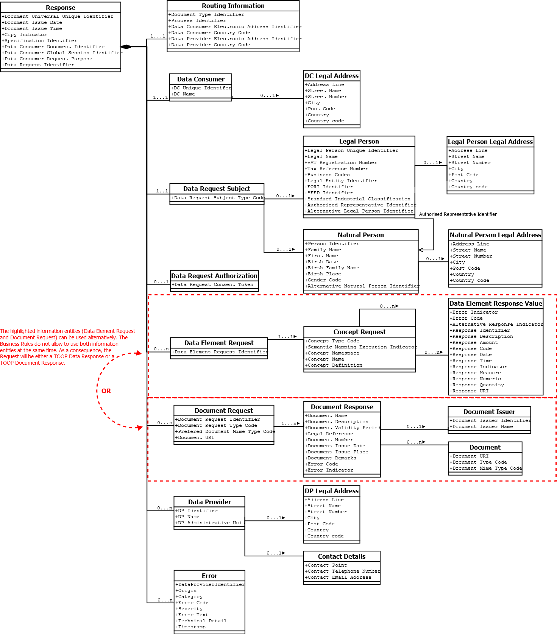
TOOP EDM Version 1.4.1

Slide 11
Mapping of EDM Version 1.4.1 to Core Vocabularies

Slide 12
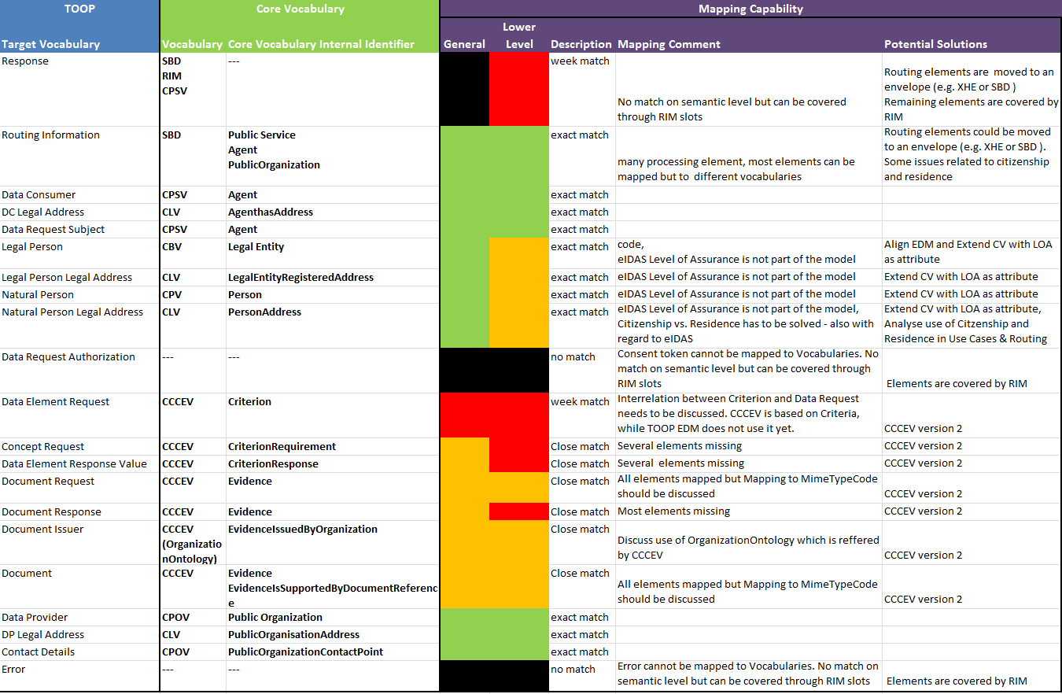
Mapping of Version 1.4.1 to Core Vocabularies

Slide 13
Envisioned TOOP EDM Version 2.0.0

Slide 14
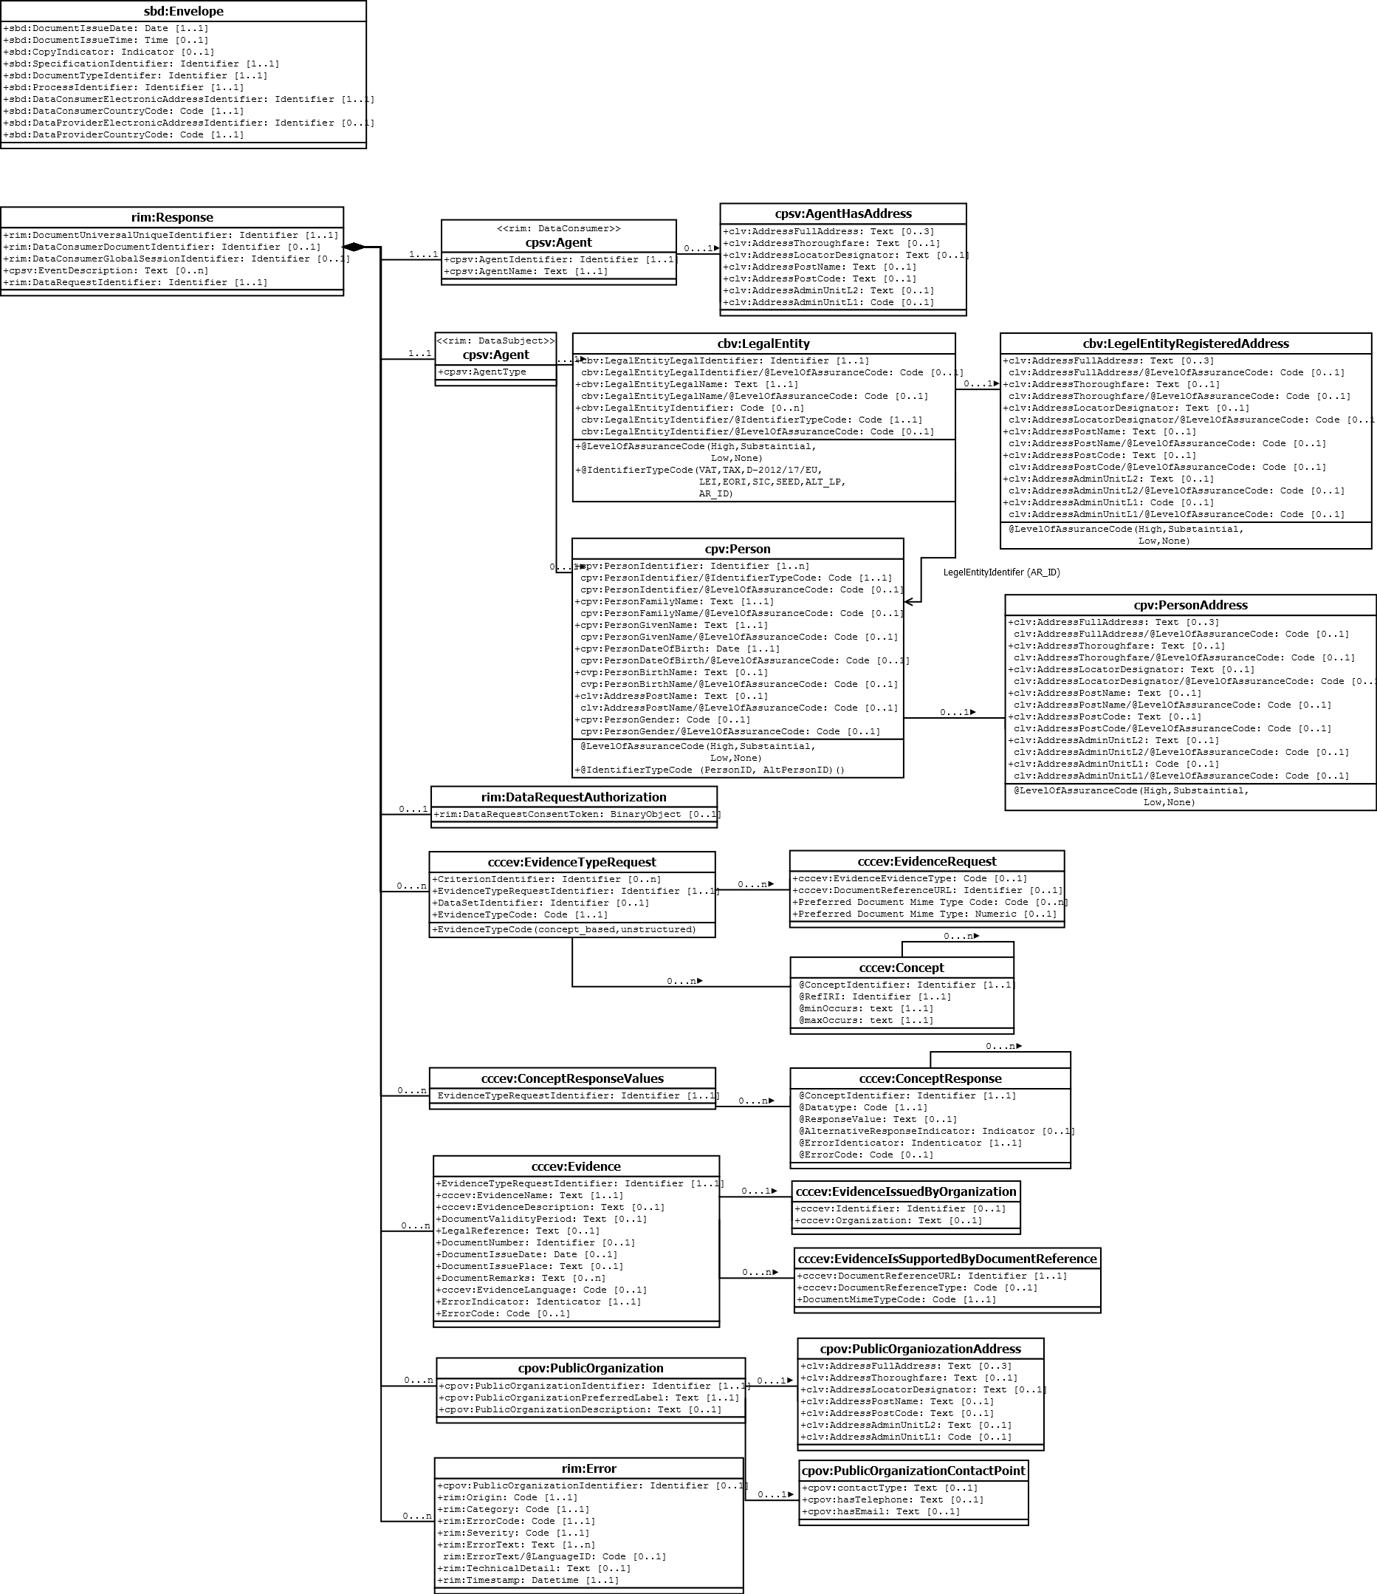
TOOP EDM Version 2.0.0

Slide 15
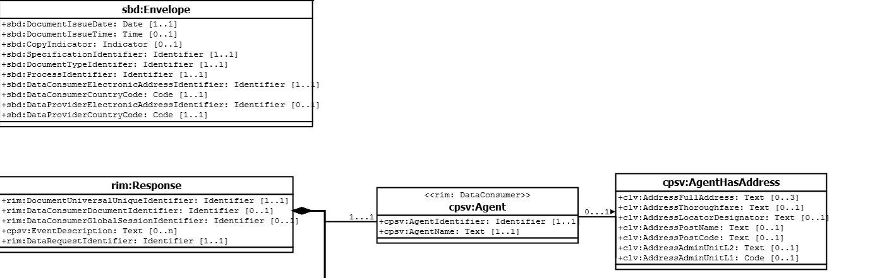
Envelope, Root Element and Data Consumer

Slide 16
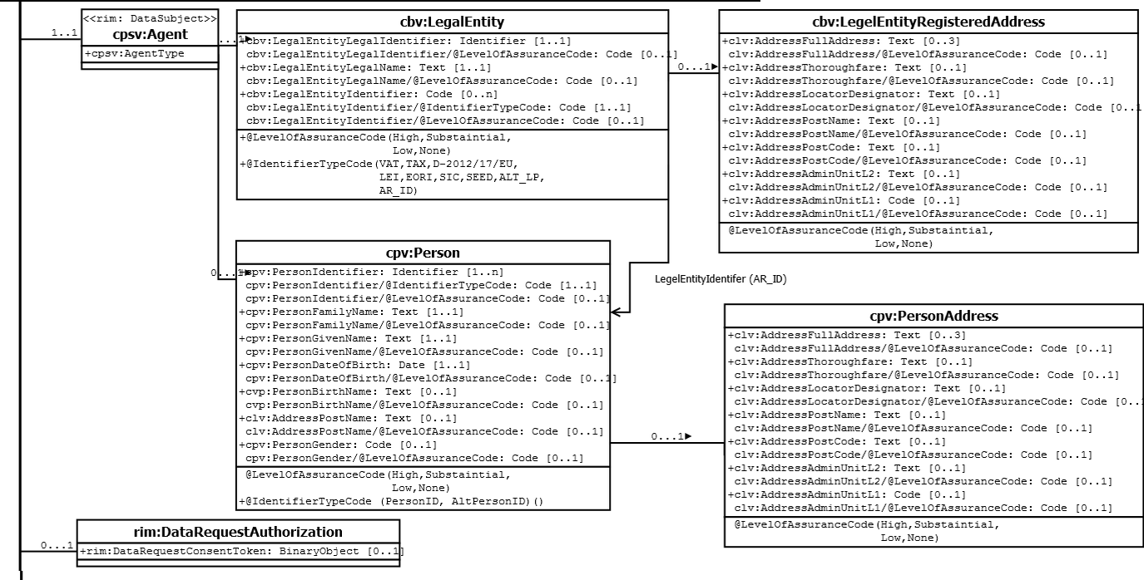
Data Subject and Expression of Consent

Slide 17
Evidence Type Requests & Responses

Slide 18
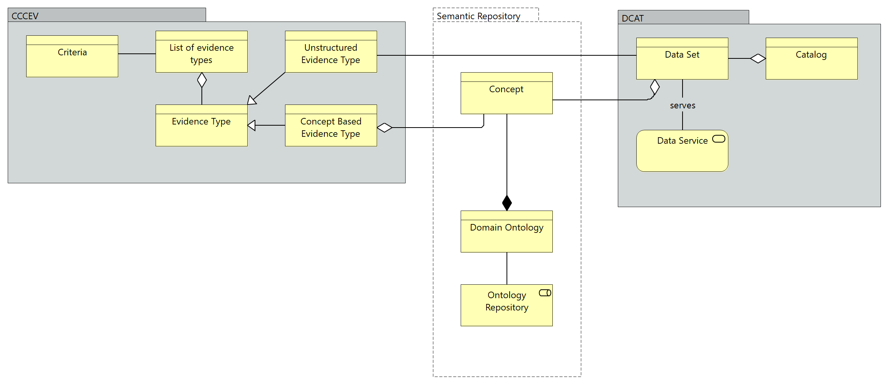
Concept Based Evidence
A dataset subset, providing the required information for proving a criterion

Slide 19
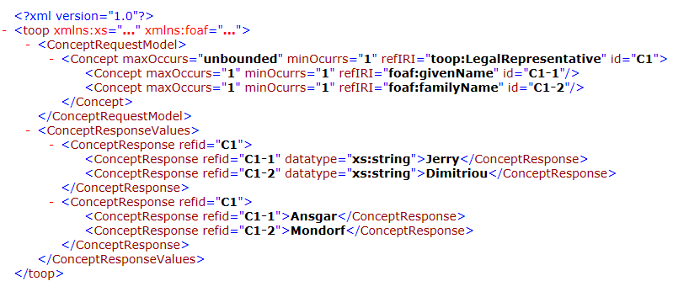
Illustration of Concept Request/Response Model
The interlinking of classes through IDs enables a better grouping of elements in the response
The encoding of elements (e.g. IDs, datatype, cardinalities) into attributes results in a slim structure

Slide 20
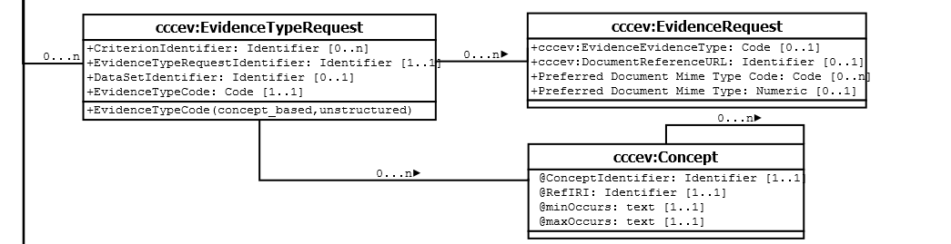
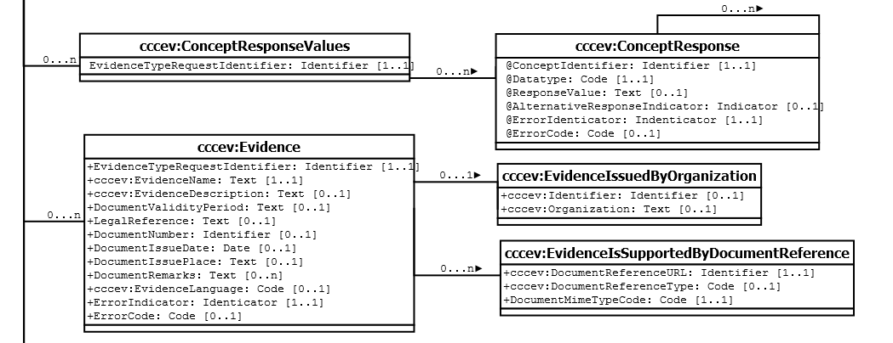
Evidence Type Requests & Responses

Slide 21
TOOP and ESPD: Similarities and Differences of the Request and Response Schemas

Slide 22
Similarities with ESPD
Grouping of Requests: ESPD uses TenderingCriterionPropertyGroups to arrange different TenderingCriterionProperties that belong together
Response Types: Responses can be provided as structure TenderingCriterionResponses or as evidence
Agnostic Structure: The ESDP uses a controlled vocabulary, the criterion taxonomy, to inform the ESPD EDM. Each element of the controlled vocabulary can be uniquely identified and might have a mandatory occurance or dependency with other elements.

Slide 23
Differences with ESPD
Expected Responses: TenderingCriterionProperties in the ESPD further restrict the expected response (Min/Max values, periods etc.) and provide further guidance to EOs whereas TOOP responses concentrate on concepts requests that need to answered by systems automatically
Domain specific EDM: ESPD is related to eProcurement whereas TOOP does not relate to a specific domain
Request Structure: The ESPD uses criteria to structure the request whereas TOOP intends to structure the request according to evidence types
and to use criteria soley to detect the evidence type and underlying data set

Slide 24
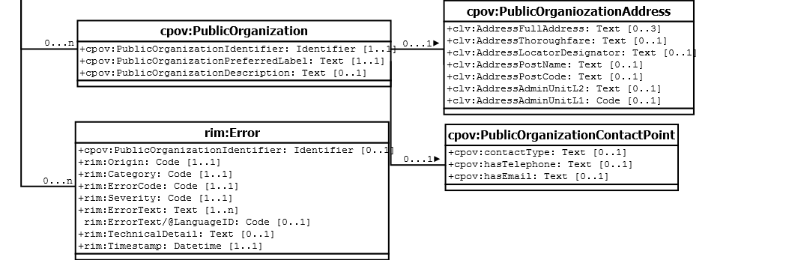
Data Provider and Technical Errors

